Slide 1


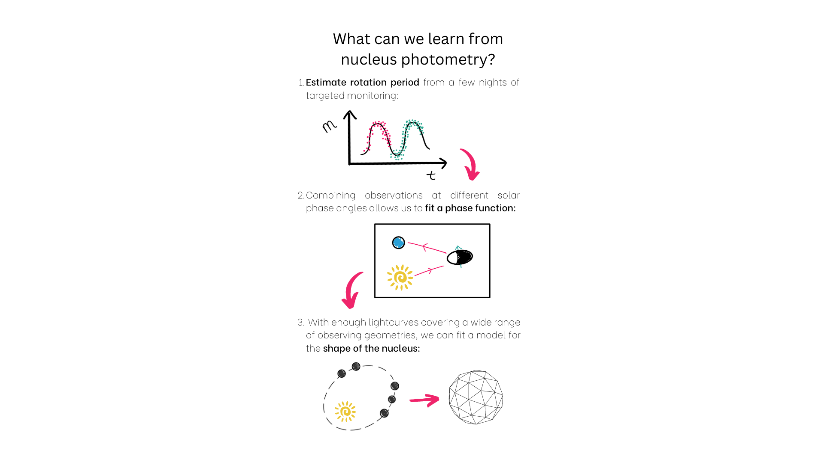
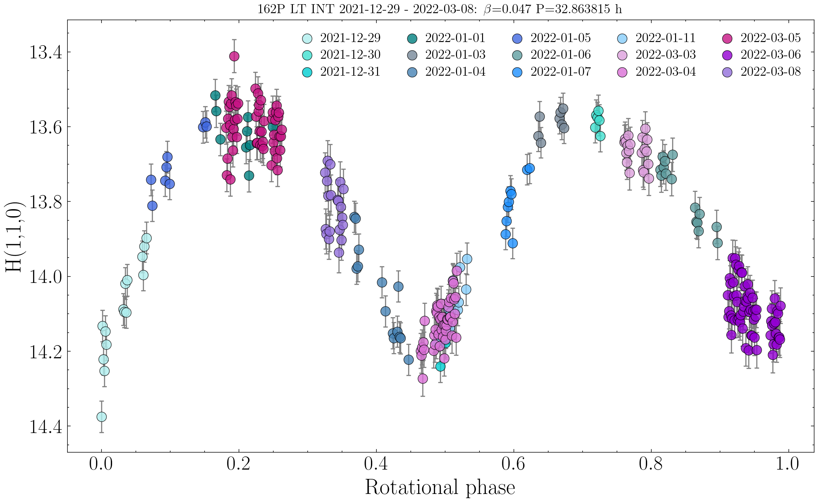


Uncovering the shapes of comets from the ground: The nucleus of comet 162P/Siding-Spring
Abbie Donaldson¹ Colin Snodgrass¹ Rosita Kokotanekova^{1,2,3} Agata Rożek¹
1. Motivation
Our knowledge of the shapes of comet nuclei has resulted primarily from a small number of in situ missions to short period comets (Figure 1) and from one radar detection [1].
These observations revealed that ~70% of the seven comet nuclei have a bilobed shape (i.e. appear to be made up of two distinct lobes). In comparison, it is estimated that only 20% of approximately 1000 near-Earth asteroids are in such ”contact binary” configurations.
Can we therefore deduce that comets undergo some unique process which leads to the formation of bilobed shapes? The present sample size of seven comets with well-constrained shapes is much too small to draw any such conclusions about the population.
Aim: Develop a method to identify the shapes of comet nuclei using solely ground-based observations.
2. What can we learn from nucleus photometry?
4. Application of convex lightcurve inversion to 162P/Siding-Spring
2. What can we learn from nucleus photometry?
We obtained new lightcurves of low-activity comet 162P in January & March 2022 (Figure 3). In total, we have collected 33 absolutely-calibrated lightcurves of this comet made up of ~1000 data points between 2007-2022.
We used CLI to search for the pole orientation and shape model that were capable of most closely reproducing these lightcurves. The distribution of poles and final shape model are shown in Figures 4 and 5.
Figure 3.
1P/Halley
19P/Borrelly
9P/Tempel 1
Figure 4. X² distribution from a grid search for the direction of the model rotation pole over all ecliptic latitude (λ) and longitude (β).
Figure 5. Best-fit convex shape model of 162P, viewed along three orthogonal directions. The model z-axis is aligned with its axis of rotation.
Figure 2.
Figure 2.
5. Discussion and scope for future work
The large, flat facets on the shape model can be interpreted as tentative evidence for a bilobed structure for 162P – CLI cannot replicate the concavities of this morphology, instead ‘covers’ them with flat regions.
The final model is dependent on phase function: we can therefore use the shape model to correct for the effects of rotation in the lightcurves and search for a cometary opposition effect by comparing shapes with different phase functions.
CLI is difficult to apply to comets: there are more limited viewing geometries available from orbits largely confined to Ecliptic plane, and the nucleus can only reliably be observed when inactive.
Upcoming surveys e.g. LSST may provide increased coverage of viewing geometries. Potential then to streamline the modelling process for a greater number of comets and acquire a larger sample of shapes.
103P/Hartley 2
67P/C-G
81P/Wild 2
3. Modeling shapes from lightcurves
The lightcurve of a small body is highly dependent on its shape and aspect [2,3] meaning that shape information can be extracted from even sparse-in-time photometry.
Convex lightcurve inversion (CLI) is a technique used to construct a convex “hull” of an object from lightcurves collected over multiple epochs and viewing geometries [4,5].
We use the software package convexinv [6] to optimise the shape, sidereal period and pole orientation which match the input comet lightcurves best.
Figure 1.* The six comets imaged by spacecraft. Four of these comets (1P, 19P, 103P and 67P) have a bilobed shape.
¹Institute for Astronomy, University of Edinburgh ²European Southern Observatory, Garching ³Institute of Astronomy and National Astronomical Observatory, Bulgarian Academy of Sciences
View this poster online:
Get in touch!
Email: a.donaldson@ed.ac.uk
Twitter: @_abbiedonaldson
References: [1] Harmon et al. (2010) [2] Karttunen (1989); [3] Karttunen & Bowell (1989); [4] Kaasalainen & Torppa (2001); [5] Kaasalainen et al. (2001); [6] Durech et al. (2010) *Image credits (top left to bottom right): 1P: Giotto/ESA 19P: NASA/JPL 9P: NASA/JPL/UMD 103P: NASA/JPL-CalTech/UMD 67P: ESA/Rosetta/MPS for OSIRIS Team MPS/UPD/LAM/IAA/ SSO/ INTA/UPM/DASP/IDA 81P: NASA

Slide 2
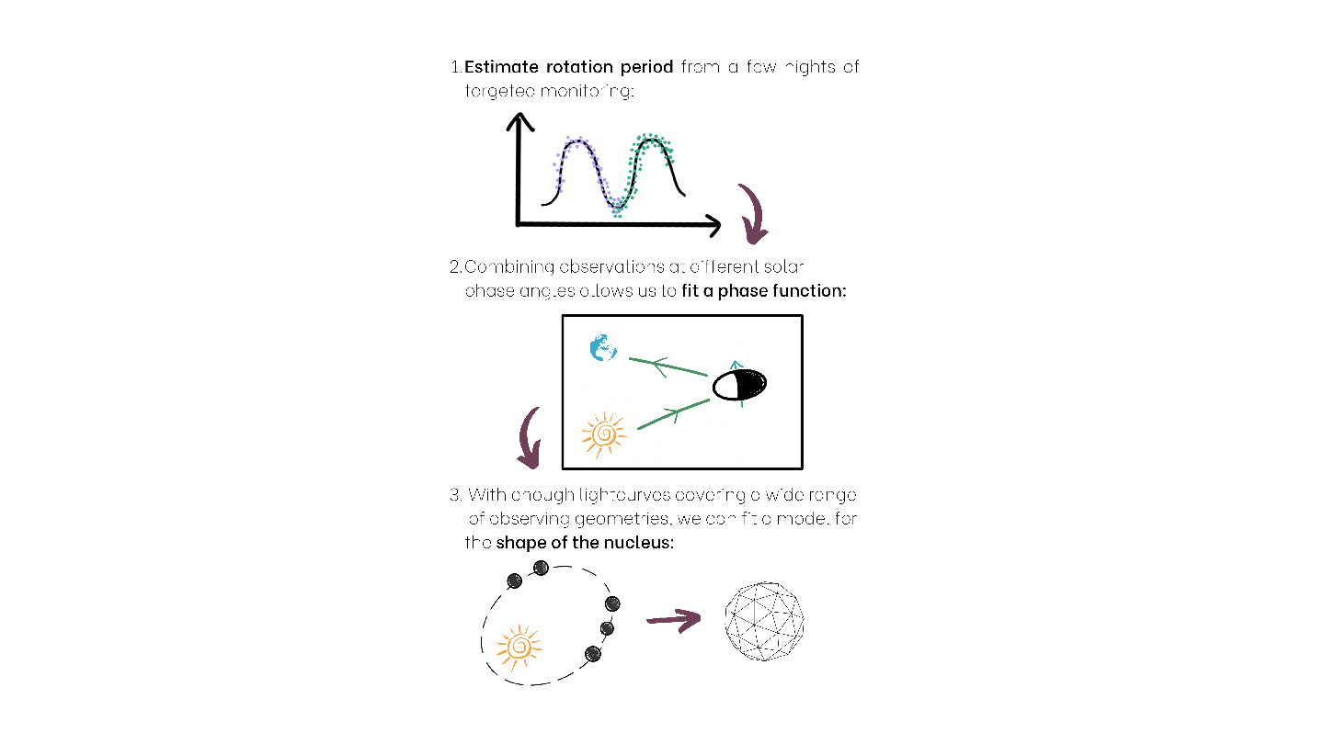
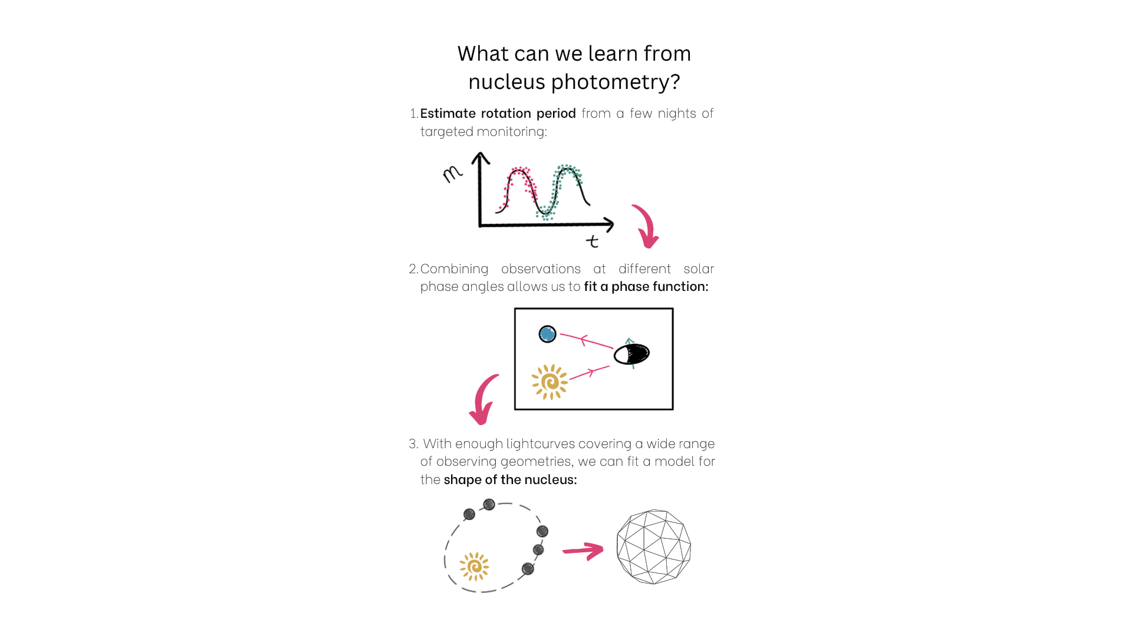

Uncovering the shapes of comets from the ground: The nucleus of comet 162P/Siding-Spring
Abbie Donaldson¹ Colin Snodgrass¹ Rosita Kokotanekova^{1,2,3} Agata Rożek¹
1. Motivation
Our knowledge of the shapes of comet nuclei has resulted primarily from a small number of in situ missions to short period comets (Figure 1) and from one radar detection [1].
These observations revealed that ~70% of the seven comet nuclei have a bilobed shape (i.e. appear to be made up of two distinct lobes). In comparison, it is estimated that only 20% of approximately 1000 near-Earth asteroids are in such “contact binary” configurations.
Can we therefore deduce that comets undergo some unique process which leads to the formation of bilobed shapes? The present sample size of seven comets with well-constrained shapes is much too small to draw any such conclusions about the population.
Aim: Develop a method to identify the shapes of comet nuclei using solely ground-based observations.
2. What can we learn from nucleus photometry?
4. Application of convex lightcurve inversion to 162P/Siding-Spring
We obtained new lightcurves of low-activity comet 162P in January & March 2022 (Figure 3). In total, we have collected 33 absolutely-calibrated lightcurves of this comet made up of ~1000 data points between 2007-2022.
We applied CLI to these lightcurves to identify the shape model and rotation pole orientation that most closely reproduced them. The distribution of poles and final shape model are shown in Figures 4 and 5.
Figure 3.
Figure 4. X² distribution from a grid search over all ecliptic latitude (λ) and longitude (β) for the direction of the model rotation pole. The solution that minimizes X² occurs at (λ, β) = (118, -50)°.
Figure 5. Best-fit convex shape model of 162P, viewed along three orthogonal directions. The model z-axis is aligned with its axis of rotation, as defined by the best fit pole coordinates in Figure 4.
1P/Halley
19P/Borrelly
9P/Tempel 1
Figure 2.
3. Modeling shapes from lightcurves
The lightcurve of a small body is highly dependent on its shape and aspect [2,3] meaning that shape information can be extracted from even sparse-in-time photometry.
Convex lightcurve inversion (CLI) is a technique used to construct a convex “hull” of an object from lightcurves collected over multiple epochs and viewing geometries [4,5].
We use the software convexinv [6] for CLI. For a given rotational period (which can also be fitted using the software), convexinv optimises the shape, pole solution and scattering parameters.
5. Discussion and scope for future work
The large, flat facets on the shape model can be interpreted as tentative evidence for a bilobed structure – CLI cannot replicate the concavities that result from this morphology, instead it ‘covers’ them with flat regions.
The final model is dependent on phase function. Therefore, we can use the shape model to correct for the effects of rotation in the lightcurves and search for a cometary opposition effect by comparing models developed with different phase functions.
CLI is challenging to apply to comets: not only is there a more limited range of viewing geometries available for orbits confined largely to the Ecliptic plane, but the nucleus can also only reliably be observed when inactive.
Upcoming surveys (e.g. LSST) may provide increased coverage of viewing geometries. Potential then to streamline the modelling process for a greater number of comets and acquire a larger sample of shapes.
103P/Hartley 2
67P/C-G
81P/Wild 2
Figure 1.* The six comets imaged by spacecraft. Four of these comets (1P, 19P, 103P and 67P) have a bilobed shape.
¹Institute for Astronomy, University of Edinburgh
²European Southern Observatory, Garching
³Institute of Astronomy and National Astronomical Observatory, Bulgarian Academy of Sciences
View this poster online:
Get in touch!
Email: a.donaldson@ed.ac.uk
Twitter: @_abbiedonaldson
Github: @ald20
References: [1] Harmon et al. (2010); [2] Karttunen (1989); [3] Karttunen & Bowell (1989); [4] Kaasalainen & Torppa (2001); [5] Kaasalainen et al. (2001); [6] Durech et al. (2010)
*Image credits (top left to bottom right): Giotto/ESA; NASA/JPL; NASA/JPL/UMD; NASA/JPL-CalTech/UMD; ESA/Rosetta/MPS for OSIRIS Team MPS/UPD/LAM/IAA/ SSO/ INTA/UPM/DASP/IDA; NASA

Slide 3
Uncovering the shapes of comets from the ground: The nucleus of comet 162P/Siding-Spring
Abbie Donaldson¹ Colin Snodgrass¹ Rosita Kokotanekova^{1,2,3} Agata Rożek¹
1. Motivation
Detailed information on the shapes of comets has come primarily from a small number of situ missions (Figure 1) and one radar detection.
These observations revealed that ~70% of seven short period comet nuclei have a bilobed shape (i.e. comprised of two distinct lobes). In comparison, it is estimated that only 20% of ~1000 near-Earth asteroids are in such contact binary configurations.
Is there a process specific to comets that results in the preferential formation of bilobed shapes? The present sample size of comet nuclei with well-constrained shapes from is too small to answer this.
Aim: Develop a method to identify the shapes of comet nuclei using solely ground-based observations.
2. What can we learn from nucleus photometry?
4. Application of convex lightcurve inversion to 162P/Siding-Spring
We obtained new lightcurves of low-activity comet 162P in January & March 2022 (Figure 3). In total, we have collected 33 absolutely-calibrated lightcurves made up of ~1000 data points between 2007-2022.
We used CLI to search for the pole orientation and shape model that were capable of most closely reproducing these lightcurves. The distribution of poles and final shape model are shown in Figures 4 and 5.
Figure 3.
Figure 4. X² distribution from a grid search for the direction of the model rotation pole over all ecliptic latitude (λ) and longitude (β).
Figure 5. Best-fit convex shape model of 162P, viewed from three orthogonal directions. The model z-axis is aligned with its axis of rotation.
Figure 2.
5. Discussion and scope for future work
The large, flat facets on the model can be interpreted as tentative evidence for a bilobed structure for 162P – CLI cannot replicate the concavities of this morphology, instead ‘covers’ them with flat regions.
Model dependent on chosen phase function: we can use the shape model to correct for the effects of rotation in the lightcurves and search for a cometary opposition effect by comparing shapes with different phase functions.
CLI is difficult to apply to comets: limited viewing geometries available from orbits largely confined to Ecliptic plane, and the nucleus can only reliably be observed when inactive.
Upcoming surveys such as LSST may provide increased coverage of viewing geometries, potential to streamline the shape modelling process for a greater number of comets and acquire a larger sample of nucleus shapes.
Figure 1. The six comets imaged by spacecraft. Four of these comets (1P, 19P, 103P and 67P) are bilobed in shape. Image credits (top left to bottom right): 1P: Giotto/ESA 19P: NASA/JPL 9P: NASA/JPL/UMD 103P: NASA/JPL-CalTech/UMD 67P: ESA/Rosetta/MPS for OSIRIS Team MPS/UPD/LAM/IAA/ SSO/ INTA/UPM/DASP/IDA 81P: NASA
3. Modeling shapes from lightcurves
The lightcurve of a small body is highly dependent on its shape and aspect [1,2] meaning that shape information can be extracted from even sparse-in-time photometry.
Convex lightcurve inversion (CLI) constructs a convex “hull” of an object from lightcurves collected over multiple epochs and viewing geometries [3,4].
We use the software package convexinv [5] to optimise the shape, sidereal period and pole orientation which match the input comet lightcurves best.
¹Institute for Astronomy, University of Edinburgh ²European Southern Observatory, Garching ³Institute of Astronomy and National Astronomical Observatory, Bulgarian Academy of Sciences
Scan QR code to view the online version of this poster.
References:
[1] Karttunen (1989) ; [2] Karttunen & Bowell (1989); [3] Kaasalainen & Torppa (2001); [4] Kaasalainen et al. (2001); [5] Durech et al. (2010)
Email: a.donaldson@ed.ac.uk

Slide 4
Uncovering the shapes of comets from the ground: The nucleus of comet 162P/Siding-Spring
Abbie Donaldson¹ Colin Snodgrass¹ Rosita Kokotanekova^{1,2,3} Agata Rożek¹
1. Motivation
Detailed information on the shapes of comets has come primarily from a small number of situ missions (Figure 1) and one radar detection.
These observations revealed that ~70% of seven short period comet nuclei have a bilobed shape (i.e. comprised of two distinct lobes). In comparison, it is estimated that only 20% of ~1000 near-Earth asteroids are in such contact binary configurations.
Is there a process specific to comets that results in the preferential formation of bilobed shapes? The present sample size of comet nuclei with well-constrained shapes from is too small to answer this.
Aim: Develop a method to identify the shapes of comet nuclei using solely ground-based observations.
2. What can we learn from nucleus photometry?
4. Application of convex lightcurve inversion to 162P/Siding-Spring
We obtained new lightcurves of low-activity comet 162P in January & March 2022 (Figure 3). In total, we have collected 33 absolutely-calibrated lightcurves made up of ~1000 data points between 2007-2022.
We used CLI to search for the pole orientation and shape model that were capable of most closely reproducing these lightcurves. The distribution of poles and final shape model are shown in Figures 4 and 5.
Figure 3.
Figure 4. X² distribution from a grid search for the direction of the model rotation pole over all ecliptic latitude (λ) and longitude (β).
Figure 5. Best-fit convex shape model of 162P, viewed from three orthogonal directions. The model z-axis is aligned with its axis of rotation.
Figure 2.
5. Discussion and scope for future work
The large, flat facets on the model can be interpreted as tentative evidence for a bilobed structure for 162P – CLI cannot replicate the concavities of this morphology, instead ‘covers’ them with flat regions.
Model dependent on chosen phase function: we can use the shape model to correct for the effects of rotation in the lightcurves and search for a cometary opposition effect by comparing shapes with different phase functions.
CLI is difficult to apply to comets: limited viewing geometries available from orbits largely confined to Ecliptic plane, and the nucleus can only reliably be observed when inactive.
Upcoming surveys such as LSST may provide increased coverage of viewing geometries, potential to streamline the shape modelling process for a greater number of comets and acquire a larger sample of nucleus shapes.
Figure 1. The six comets imaged by spacecraft. Four of these comets (1P, 19P, 103P and 67P) are bilobed in shape. Image credits (top left to bottom right): 1P: Giotto/ESA 19P: NASA/JPL 9P: NASA/JPL/UMD 103P: NASA/JPL-CalTech/UMD 67P: ESA/Rosetta/MPS for OSIRIS Team MPS/UPD/LAM/IAA/ SSO/ INTA/UPM/DASP/IDA 81P: NASA
3. Modeling shapes from lightcurves
The lightcurve of a small body is highly dependent on its shape and aspect [1,2] meaning that shape information can be extracted from even sparse-in-time photometry.
Convex lightcurve inversion (CLI) constructs a convex “hull” of an object from lightcurves collected over multiple epochs and viewing geometries [3,4].
We use the software package convexinv [5] to optimise the shape, sidereal period and pole orientation which match the input comet lightcurves best.
¹Institute for Astronomy, University of Edinburgh ²European Southern Observatory, Garching ³Institute of Astronomy and National Astronomical Observatory, Bulgarian Academy of Sciences
Scan QR code to view the online version of this poster.
References:
[1] Karttunen (1989) ; [2] Karttunen & Bowell (1989); [3] Kaasalainen & Torppa (2001); [4] Kaasalainen et al. (2001); [5] Durech et al. (2010)
Email: a.donaldson@ed.ac.uk

Slide 5
Uncovering the shapes of comets from the ground: The nucleus of comet 162P/Siding-Spring
Abbie Donaldson¹ Colin Snodgrass¹ Rosita Kokotanekova^{1,2,3} Agata Rożek¹
1. Motivation
Our knowledge of the shapes of comet nuclei has resulted primarily from a small number of in situ missions to short period comets (Figure 1) and from one radar detection [1].
These observations revealed that ~70% of the seven comet nuclei have a bilobed shape (i.e. appear to be made up of two distinct lobes). In comparison, it is estimated that only 20% of approximately 1000 near-Earth asteroids are in such ”contact binary” configurations.
Can we therefore deduce that comets undergo some unique process which leads to the formation of bilobed shapes? The present sample size of seven comets with well-constrained shapes is much too small to draw any such conclusions about the population.
Aim: Develop a method to identify the shapes of comet nuclei using solely ground-based observations.
2. What can we learn from nucleus photometry?
4. Application of convex lightcurve inversion to 162P/Siding-Spring
We obtained new lightcurves of low-activity comet 162P in January & March 2022 (Figure 3). In total, we have collected 33 absolutely-calibrated lightcurves of this comet made up of ~1000 data points between 2007-2022.
We used CLI to search for the pole orientation and shape model that were capable of most closely reproducing these lightcurves. The distribution of poles and final shape model are shown in Figures 4 and 5.
Figure 3.
1P/Halley
19P/Borrelly
9P/Tempel 1
Figure 4. X² distribution from a grid search for the direction of the model rotation pole over all ecliptic latitude (λ) and longitude (β).
Figure 5. Best-fit convex shape model of 162P, viewed from three orthogonal directions. The model z-axis is aligned with its axis of rotation.
Figure 2.
5. Discussion and scope for future work
The large, flat facets on the shape model can be interpreted as tentative evidence for a bilobed structure for 162P – CLI cannot replicate the concavities of this morphology, instead ‘covers’ them with flat regions.
The final model is dependent on phase function: we can therefore use the shape model to correct for the effects of rotation in the lightcurves and search for a cometary opposition effect by comparing shapes with different phase functions.
CLI is difficult to apply to comets: there are more limited viewing geometries available from orbits largely confined to Ecliptic plane, and the nucleus can only reliably be observed when inactive.
Upcoming surveys e.g. LSST may provide increased coverage of viewing geometries. Potential then to streamline the modelling process for a greater number of comets and acquire a larger sample of nucleus shapes.
103P/Hartley 2
67P/C-G
81P/Wild 2
3. Modeling shapes from lightcurves
The lightcurve of a small body is highly dependent on its shape and aspect [2,3] meaning that shape information can be extracted from even sparse-in-time photometry.
Convex lightcurve inversion (CLI) is a technique used to construct a convex “hull” of an object from lightcurves collected over multiple epochs and viewing geometries [4,5].
We use the software package convexinv [6] to optimise the shape, sidereal period and pole orientation which match the input comet lightcurves best.
Figure 1.* The six comets imaged by spacecraft. Four of these comets (1P, 19P, 103P and 67P) have a bilobed shape.
View this poster online:
Get in touch!
Email: a.donaldson@ed.ac.uk
Twitter: @_abbiedonaldson
¹Institute for Astronomy, University of Edinburgh ²European Southern Observatory, Garching ³Institute of Astronomy and National Astronomical Observatory, Bulgarian Academy of Sciences
References: [1] Harmon et al. (2010) [2] Karttunen (1989) ; [3] Karttunen & Bowell (1989); [4] Kaasalainen & Torppa (2001); [5] Kaasalainen et al. (2001); [6] Durech et al. (2010) *Image credits (top left to bottom right): 1P: Giotto/ESA 19P: NASA/JPL 9P: NASA/JPL/UMD 103P: NASA/JPL-CalTech/UMD 67P: ESA/Rosetta/MPS for OSIRIS Team MPS/UPD/LAM/IAA/ SSO/ INTA/UPM/DASP/IDA 81P: NASA

Slide 6

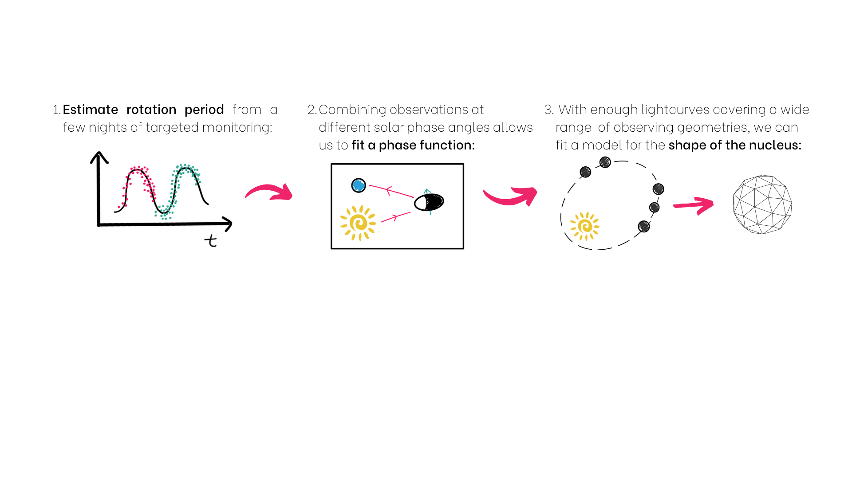
Uncovering the shapes of comets from the ground: The nucleus of comet 162P/Siding-Spring
Abbie Donaldson¹ Colin Snodgrass¹ Rosita Kokotanekova^{1,2,3} Agata Rożek¹
Motivation
Information on the shapes of comet nuclei has come primarily from a small number of situ missions (Figure 1) and one radar detection.
70% of seven short period comet nuclei show a bilobed morphology.
It is estimated that 20% of ~1000 radar-detected near-Earth asteroids could be contact binaries.
Is there a process specific to comets that results in the preferential formation of bilobed shapes? The sample size of comet nuclei with well-constrained shapes is currently too small to draw any conclusions.
What can we learn from nucleus photometry?
Phase function considerations
When using absolutely-calibrated lightcurves, it is necessary to fit a phase function as part of the shape modelling procedure.
Asteroids and other small solar system bodies show evidence for an opposition effect at phase angles ~0, but this phenomenon has not been detected from the ground for comet nuclei: a purely linear phase function is typically suitable for these dark objects at low solar phase (Figure 2).
Figure 2. Phase function fits to the rotationally-corrected 162P lightcurve points. The solid line shows the best-fitting linear fit; the dash line shows the best-fitting HG
Results for 162P/Siding Spring
162P is a large (R_{eff} ~ 7km), inactive JFC with a rotation period approximately 32.8h.
Extensive existing R-band lightcurve coverage between 2007 and 2018.
Geometric albedo 2.2% - one of the darkest surfaces of all studied comets [1].
Fitting shapes by convex lightcurve inversion
The shape of a small body has a larger effect on its rotational lightcurve than variations in light scattering properties across its surface [4,5]: we can therefore extract shape information from even sparse-in-time photometric data.
Convex lightcurve inversion (CLI) used to construct a convex “hull” of an object using lightcurve points collected over many epochs and a range of viewing geometries.
Technique is routinely used to model asteroid shapes [6,7,8], but only comet 67P/Churyumov-Gerasimenko (Rosetta mission target) has been modelled by this method to date.
Software package convexinv used here: For a given sidereal period and pole orientation, convexinv optimises convex shape and pole orientation that best fits the input lightcurves.
Figure 1. The six comets to have been imaged in situ. Image credits (top left to bottom right): 1P: Giotto/ESA 19P: NASA/JPL 9P: NASA/JPL/UMD 103P: NASA/JPL-CalTech/UMD 67P: ESA/Rosetta/MPS for OSIRIS Team MPS/UPD/LAM/IAA/SSO/INTA/UPM/DASP/IDA 81P: NASA
Aims of this work:
Combine new and existing lightcurves of Jupiter-family comet (JFC) 162P/Siding-Spring to create a convex model of its nucleus.
Explore to what extent convex lightcurve inversion can be used to expand the number of comets with well-constrained shape information.
Refine the method for fitting cometary phase functions using the resulting shape models to correct lightcurves for the rotation of the nucleus.
Comet property | Value
Rotation period | ~32.8 h
Geometric albedo | 0.022
Radius | 7 km
¹Institute for Astronomy, University of Edinburgh; ²European Southern Observatory, Garching; ³Institute of Astronomy and National Astronomical Observatory, Bulgarian Academy of Sciences
^{REFERENCES}

